Slide 1
Session Layer
OSI Model

Slide 2

Session layer
Receiver
Sender

Slide 3
The session layer is responsible for dialog
control and synchronization.

Slide 4
LAYER 5: SESSION
The session layer defines how to start, control and end conversations (called sessions) between applications.
This includes the control and management of multiple bi-directional messages using dialogue control.
It also synchronizes dialogue between two hosts' presentation layers and manages their data exchange.
The session layer offers provisions for efficient data transfer.

Slide 5
Basic Functions for the Session Layer Protocols
Creating a connection – session/communication session between an APPLICATION in one computer and another APPLICATION in another computer
  THREE-WAY-HANDSHAKE: a method widely used to establish and end connection
    Sender sends SYN message to request a session to the receiver
    Receiver replies by sending ACK message to acknowledge the SYN message sent by the sender, and SYN message to request a session to the sender
    Sender replies by sending ACK message to acknowledge the SYN message sent by the receiver

Slide 6
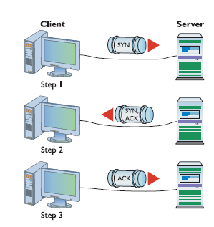
Basic Functions for the Session Layer Protocols

Slide 7
Basic Functions for the Session Layer Protocols
Managing multiple sessions
  A computer can establish multiple sessions with several other computers
    e.g., session 1: exchanging information over the World Wide Web with www.yahoo.com
    session 2: exchanging information over the World Wide Web with www.google.com
    session 3: exchanging information over the World Wide Web with www.espn.com
  Two computers can also establish multiple sessions,
    e.g., function 1: exchanging information over the World Wide Web;
    function 2: exchanging information over the FTP;
    function 3: exchanging information over the email

Slide 8
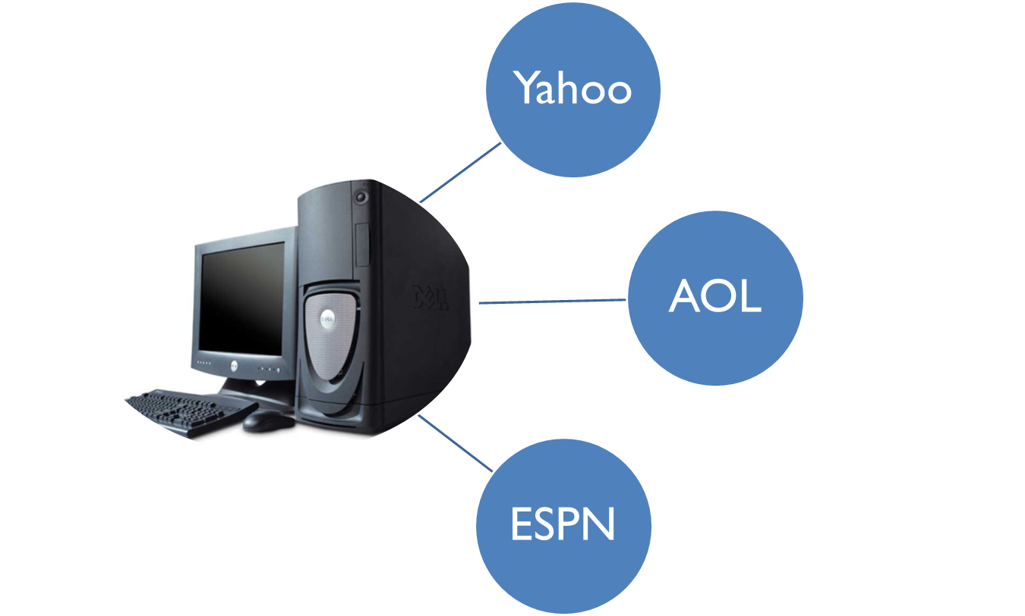
A computer can establish multiple sessions with several other computers

Slide 9


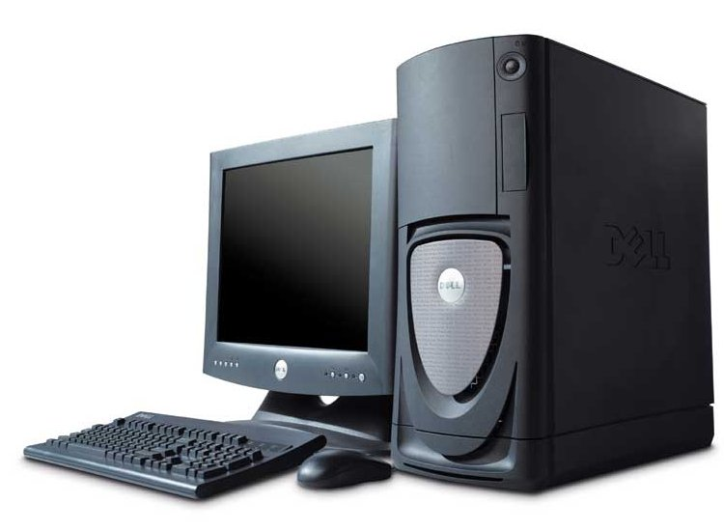
Two computers can establish multiple sessions
mail
music
news

Slide 10
Basic Functions for the Session Layer Protocols
Ending a session
  THREE-WAY-HANDSHAKE: a method widely used to establish and end connection
    Sender sends FIN message to close a session to the receiver
    Receiver replies by sending ACK message to acknowledge the FIN message sent by the sender, and FIN message to close a session to the sender
    Sender replies by sending ACK message to acknowledge the FIN message sent by the receiver

Slide 11
Session Layer protocols
ISO-SP: OSI Session Layer Protocol
PPTP, Point-to-Point Tunneling Protocol
RPC, Remote Procedure Call Protocol
RTCP, Real-time Transport Control Protocol
SQL is a Session layer application that manages multiple queries to the SQL database.

